Slide 1
Business Insights on Honey Production DECLINE in the US
Presented by
Palak Grover
GLDA BLR Dec 22 Batch

Slide 2
STAR FORMAT: Honey Production in the US
Situation - The business problem is about the decline of the honey production in the US from 1998 to 2012
Task - To investigate the decline of honey bee production in the US and how the trends of the past will enable us to predict the future for the honeybees in the country
4D Framework:
Part -1 - Data
Part - 2 - Descriptive Analysis
Part - 3 - Data Modeling
Part - 4 - Deploy the Model
In this project, we are focusing only on Data and Descriptive Analysis

Slide 3
Continued….
Data
We have the data from the of the dataset for the honey production supply and demand in America by state from 1998 to 2012. We have features like 'state', 'numcol', 'yieldpercol', 'totalprod', 'stocks', 'priceperlb','prodvalue', 'year' The average production of honey in particular states and the total production done yearly basis
2. Descriptive Analysis
Data cleaning
Analysis of Honey Bee Production in the US from 1998 to 2012
Data Standardization
Visualization of average honey bee production, average stock and average price per pound in the US over the years.
Descriptive Analysis - "Summarizing via visualization“
Results for the decline of honey production in the US

Slide 4
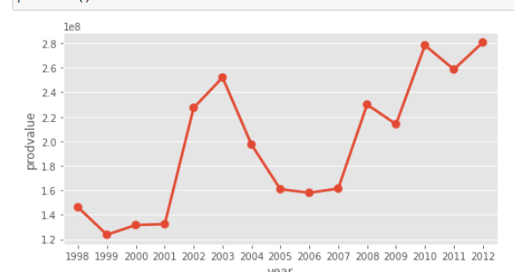
Variation of Honey Production Value with Year
It can be observed that there is in flattened production value from 1999 to 2001. A sharp rise from 2001 to 2004.
Then constant from 2004 to 2007, then increase-decrease pattern is seen from 2007 till 2012

Slide 5
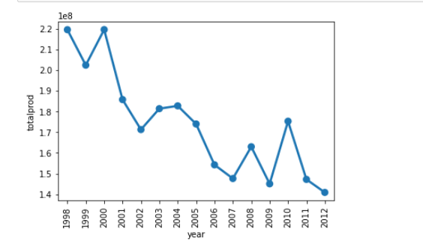
Variation of Total Production Year-by-Year
The below trend shows a decline in the total honey production from 2008 to 2012 in the US

Slide 6
Continued….
The total production over the years can be calculated by the following formula:
Total honey production = number of colonies * average yield per colony
Now, we need to check if the factors such as numcol and average yieldpercol affected the total honey production, now, let us check this

Slide 7
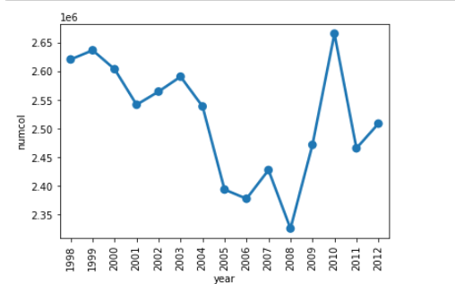
Variation of Honey Bee Numcols Year-by-Year
The below count plot for number of honey bee colonies with year shows the decreasing trend from 1998 to 2008. 2008 is the point after which colonies started rising again
Meaning, some modifications were done that helped in increasing the "Honey" production from 2008 to 2012.

Slide 8
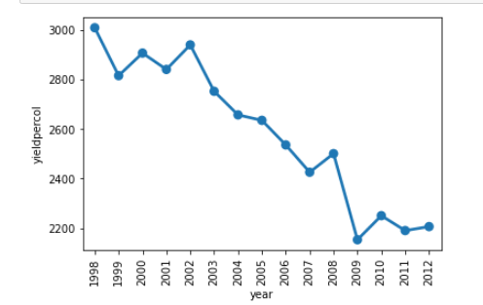
Variation of Honey Yield Year-by-Year
From 1998 to 2001, there was a decrease, then an increase was seen in 2002, however, after 2002, a continuous decrease was seen till 2007. A rise in 2008. Again, the decrease was seen till 2012.
Hence, for the above formula for The Total Honey Production, the honey production is getting affected by the 'Yieldpercol' not by 'Numcol'
Now, if I want to see state-wise total production on yearly basis, another trend was observed, which we will discuss in the next slide

Slide 9
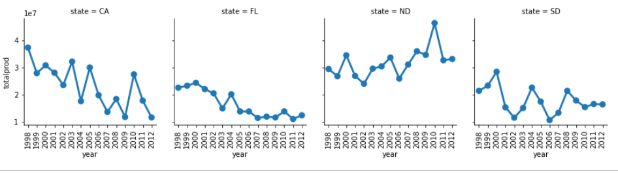
Variation of Total Honey Production Year-by-Year
With regards to honey production, the states we need to focus on are ND, SD, FL, and CA
Only state 'ND' showed a "perfect" increase in the total production then some decrease later on
SD showed increase from 1998, reached the peak at 2000, then lowest at 2002, then increase, then decrease and reached stability in the last years, i.e., 2011 and 2012
State CA showed a declining trend in the total production over the years
State FL showed increase in an year at the middle, but continuously, it shows a decreasing trend

Slide 10
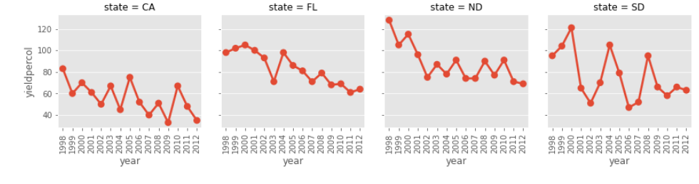
Variation of Honey Yield Year-by-Year
Now, let us how much each honey colony yields in these four states: ND, SD, FL, CA
It can be seen in a graph that the total production for ND was the highest, but yield per col is at the peak in 1998, which is now shown decreasing.
Hence, all four states show decreasing trend for yield per colony, year-wise

Slide 11
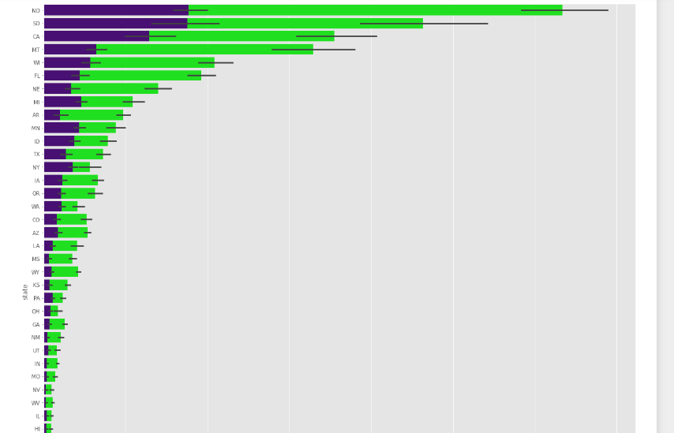
Total Production State and Year Wise

Slide 12
Total Production State and Year Wise: Inferences
The order of the high total production state wise was seen as:
ND
SD
CA
MT
WI
FL
NE
MI

Slide 13
Continued….
Now, the stocks out of the total production state-wise can be seen as:
ND, SD Equal
CA
MT
WI
MI, MN Equal
FL
ID, NY Equal
TX
Hence, the most focusing honey producing states are ND, SD, CA, MT, WI, FL, NE, and MI Now, I would like to check the average price of honey per pound across these states. For this, I need to compute the mean of the priceperpound and that too state-wise

Slide 14
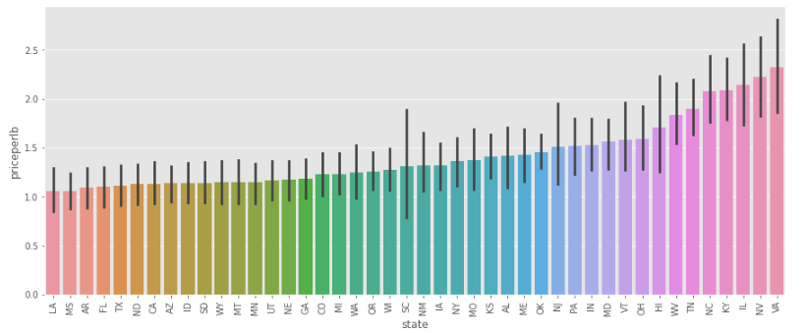
Average Price Per Pound State -Wise

Slide 15
Average Price Per Pound State –Wise: Inferences
1. Costly Honey - Avg Price Per Pound
VA - The costly state in terms of avg price per lb for honey
NV - The second highest
IL - The third highest
2. Lower Avg price per pound states
LA - State with the lowest avg-price-per-lb
MS - State with the second lowest avg price per lb
AR – State with the third lowest avg price per lb
Considering the states: ND, SD, CA, MT, WI, FL, NE, and MI, the average price per pound is lower
Now, considering the states having higher stocks: (ND, SD), MT, WI, (MI/MN), FL, (ID,NY), TX, the average price per pound are on the left side, or lower prices

Slide 16
Continued….
However, the states like VA, NV, IL, KY have lower honey total production and lower stocks of honey have higher avg_price_per_pound that we can on the right side of our graph above for "priceperlb" vs "state“
Now, we will verify the states: ['ND','SD','CA','MT','WI','FL','NE','MI'] have a higher avg -prod value because of which the avg price per pound for these states is lesser

Slide 17
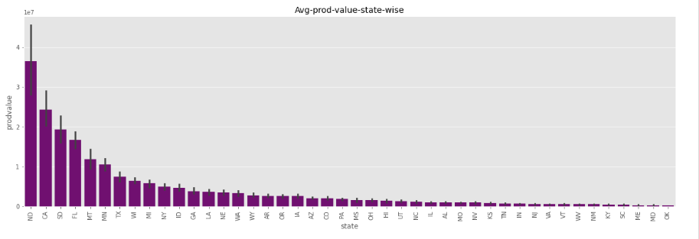
Average Production Value State Wise
The average production value for states: ['ND','SD','CA','MT','WI','FL','NE','MI'] was higher because of which average price per pound was lesser

Slide 18
Business Insights: Honey Production Decline in the US
1. The total production was affected by yield per colony
2. The state having more total production and the average production value were the ones having the lower avg price per pound for honey
3. The states like ND, SD, CA, MT, WI, FL, NE, and MI were having avg lower price per lb while VA was the state highest avg price per lb
4. The states CA, FL, ND, SD showed a good trend of total product year-wise and are the most focusing states for honey production in the US

Slide 19
Continued…
5. The states like ND, SD, FL, and CA were the most focusing states, as the graph of these states show clarity in the honey production. These four states show decreasing trend for yield per colony
Hence, with less production, avg price per pound is higher, also, yield per colony year-wise also show decreasing trend state-wise, which is a matter that needs to work on.

Slide 20
Thank You

